Slide 1


Hospitality
Solutions Overview
Transforming Homes with Smart, Secure, and Scalable Automation
www.interratechnology.com

Slide 2
Content
Hotels Challenges
Integrating KNX and Non-KNX Protocols
Solutions Integration
Application Scenarios and Cases.
Q&A and Discussion
www.interratechnology.com

Slide 3








Hotels Automation Challenges
Disjointed Automation protocols and solutions
Automation Protocols
PMS Softwares
Alarm Systems
Access Control
www.interratechnology.com

Slide 4



Hotels Automation Challenges
The main challenges hotels face
Fragmented ecosystems
Energy deficiency
Security breaches
www.interratechnology.com

Slide 5




Hotels Automation Challenges
The Impact of These Challenges on Hotels
Poor Guest Experience
High Energy Bills
Operational Complexity
Security Risks
www.interratechnology.com

Slide 6
How We Solve Hospitality Challenges ?
www.interratechnology.com

Slide 7


2. Integrating KNX and Non-KNX Protocols
For System Integrators:
GRMS is key for winning hospitality projects and enables cross-selling.
Rapidly growing global market, including new and retrofit projects.
Few competitors offer a full product range.
Simplifies compliance with new regulations. (e.g, energy efficiency,
ease of use, Co2 emission, flexibility …)
For Hotels:
Differentiate with a unique customer experience.
Enhance comfort, ease of use, and innovation
Boost satisfaction and loyalty
Implement cost-efficient scenarios for guests and staff.
www.interratechnology.com

Slide 8














2. Integrating KNX and Non-KNX Protocols
In-room
control
GRMS
Common areas
Control
Access Control
server
PMS/BMS
www.interratechnology.com

Slide 9
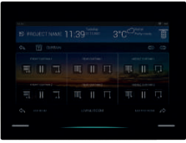
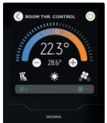
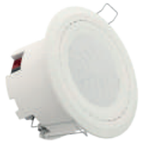

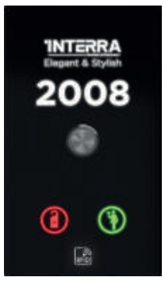
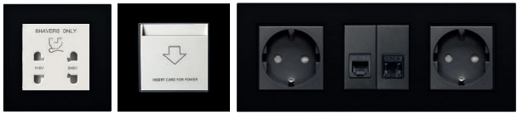
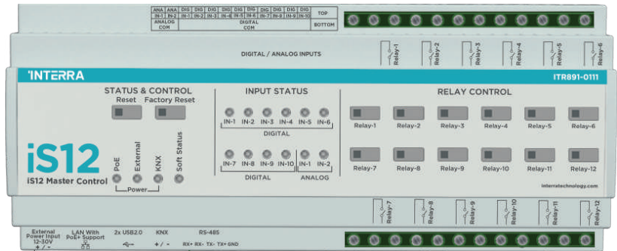
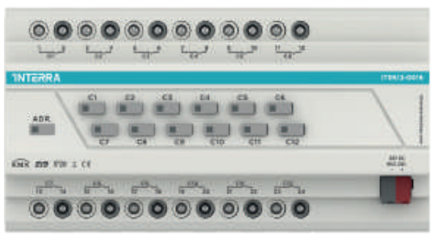
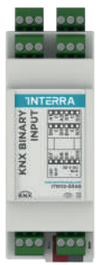
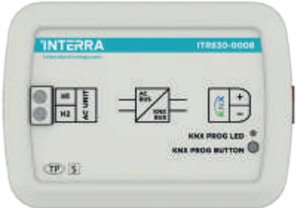
2. Integrating KNX and Non-KNX Protocols
In-Room KNX Control
Sensors
  Touch Panels (Full control, Thermostat, DND/MUR …)
  Keypads (Full control, thermostat, DND/MUR…)
  Multi Sensors (virtual card holder, I/O, Thermostat…)
2. Modules
  iS12 master control (KNX/EIO)
  KNX Actuators
  KNX AC Gateways
  KNX Binary Inputs
www.interratechnology.com

Slide 10
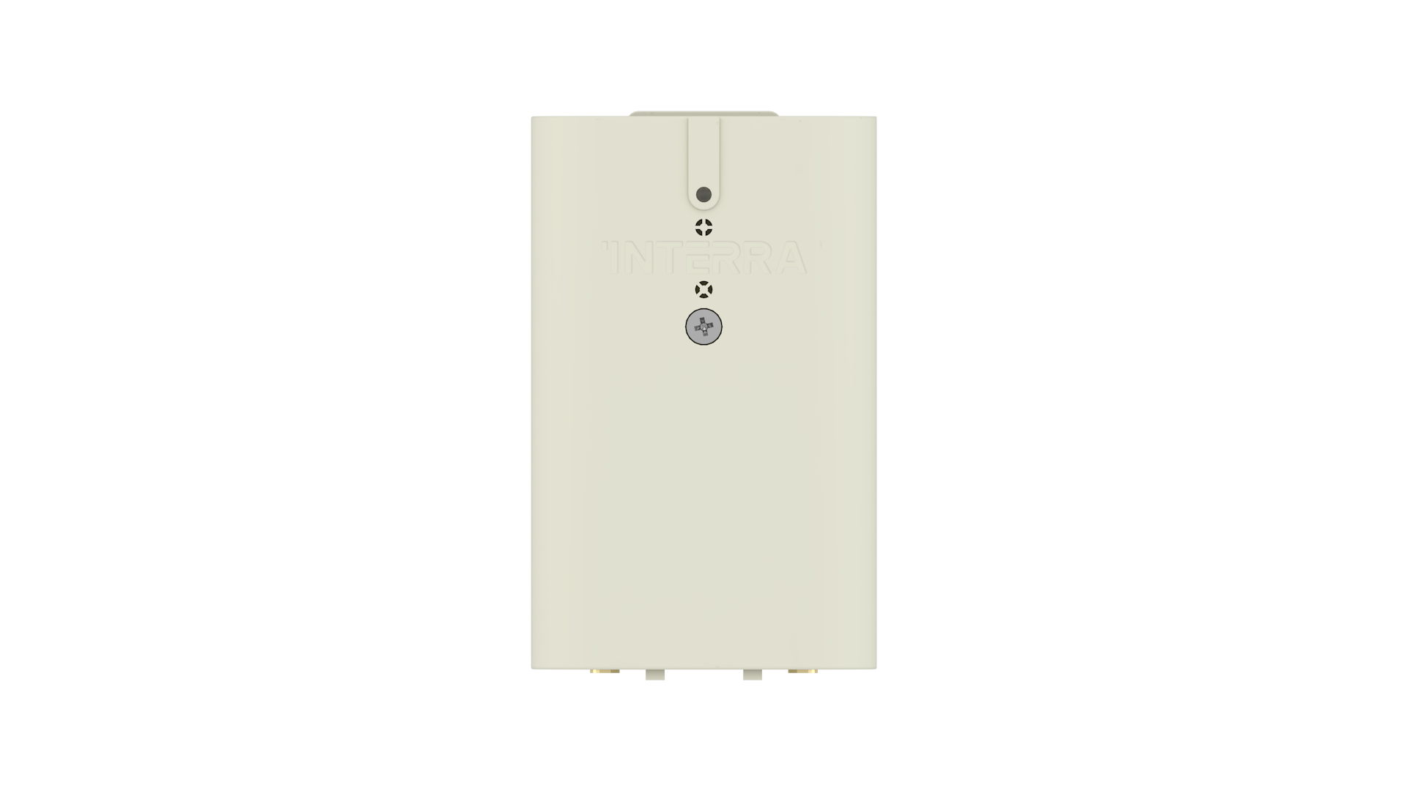
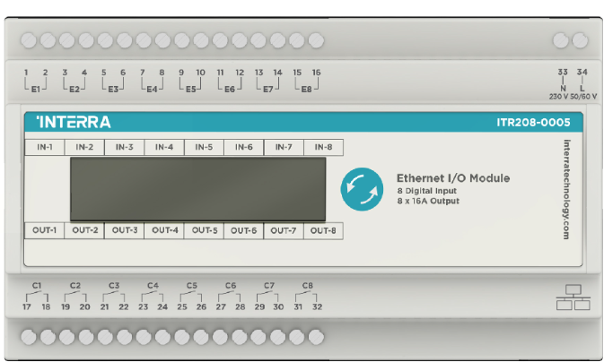
2. Integrating KNX and Non-KNX Protocols
In-Room EIO Control
Sensors
  Touch Panels (Full control, Thermostat, DND/MUR …)
  Keypads (Full control, thermostat, DND/MUR…)
  Multi Sensors (Presence, Motion, water flood, thermostat etc…)
2. Modules
  iS12 master control
  EIO Modules
www.interratechnology.com

Slide 11
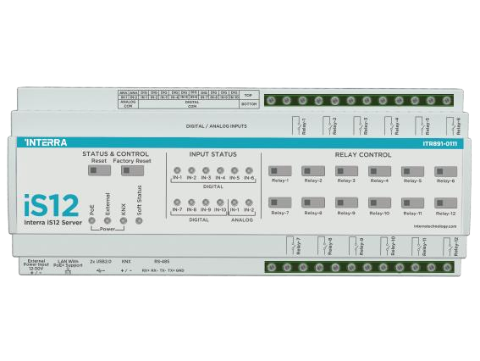
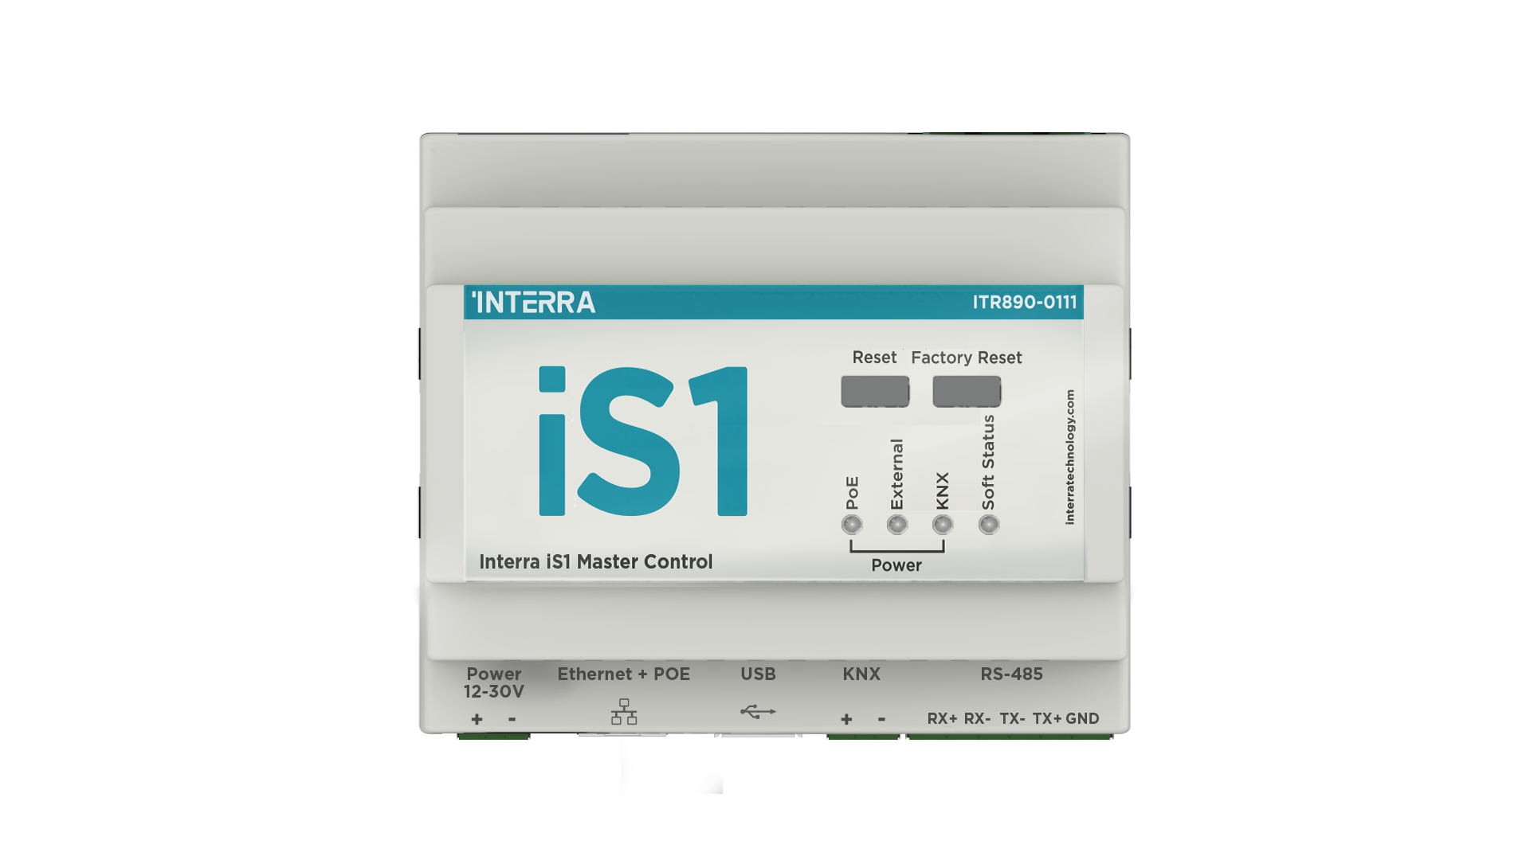
3. Products Integration
iS12 and iS1
KNX TP
Modbus
Bacnet
HTTP/REST API
Websockets
Logic Server
Everything in iS1
12 Outputs
12 Inputs (12 digital or 10 digital + 2 analog)
www.interratechnology.com

Slide 12

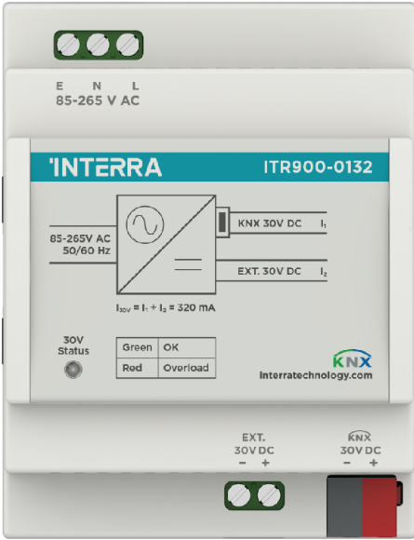
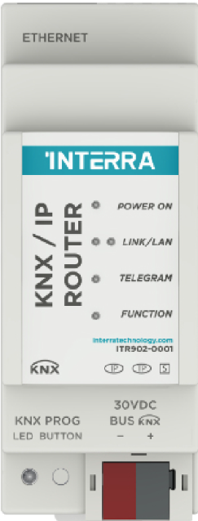
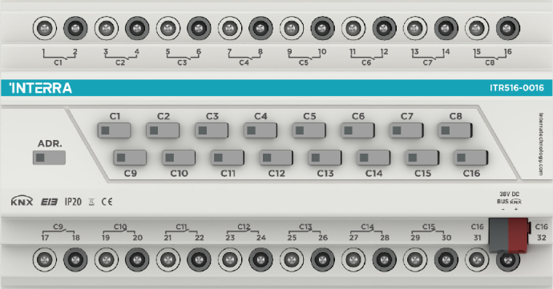
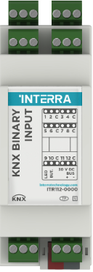
3. Application Scenarios and cases.
Option 1, without iS12
Option 2, with iS12
TCP/IP
85/265V AC
Aux PS 30 VDC
KNX TP
30V DC
KNX
TCP/IP
POE+
KNX Combo Actuator
iS12
KNX Power supply
IP
ROUTER
Binary Input
+
+
+
KNX
EIO
www.interratechnology.com

Slide 13
3. Products Integration
Expansion Options
KNX TP
TCP/IP
www.interratechnology.com

Slide 14
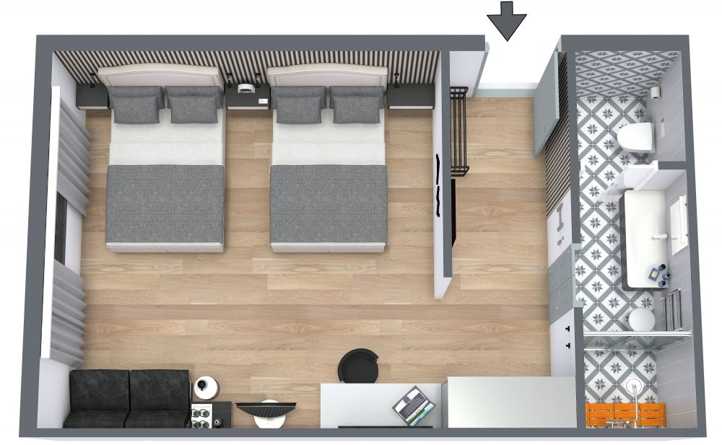



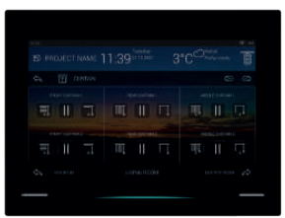
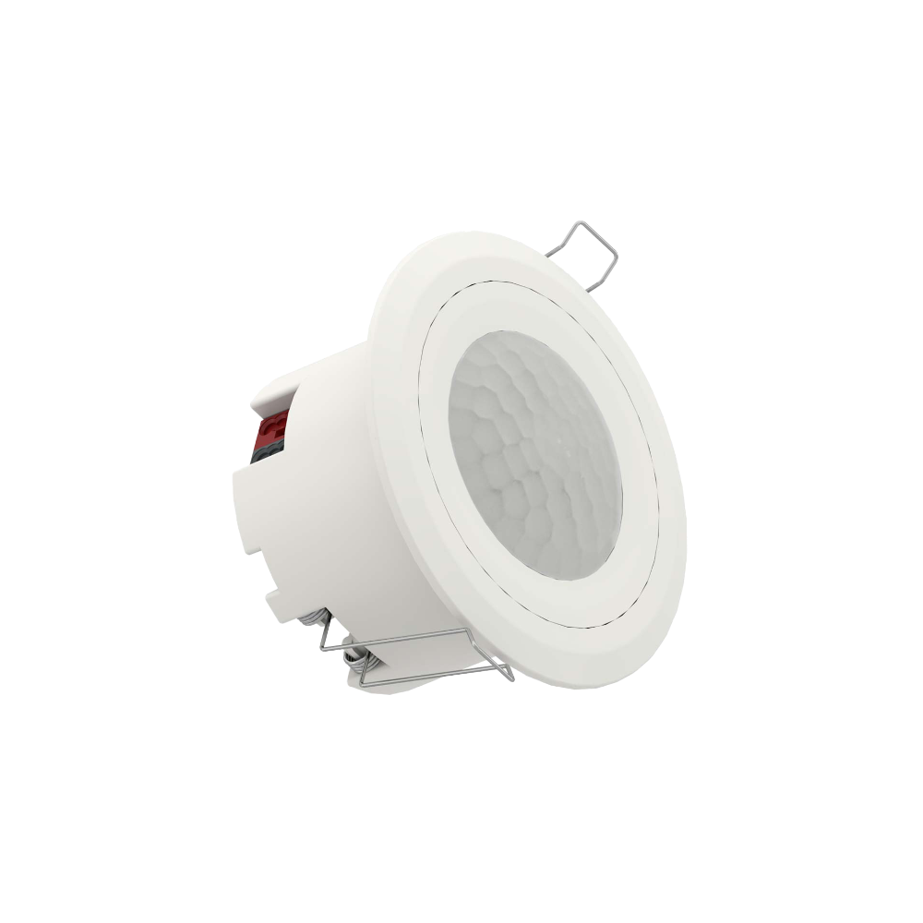



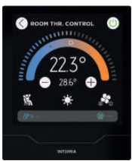
2. Integrating KNX and Non-KNX Protocols
Room Plan Type A: Use Case of KNX
www.interratechnology.com

Slide 15

2. Integrating KNX and Non-KNX Protocols
Room Plan Type B: Use Case of EIO
www.interratechnology.com

Slide 16

3. Solutions Integration: Floor plan
IP Network Switch
www.interratechnology.com

Slide 17
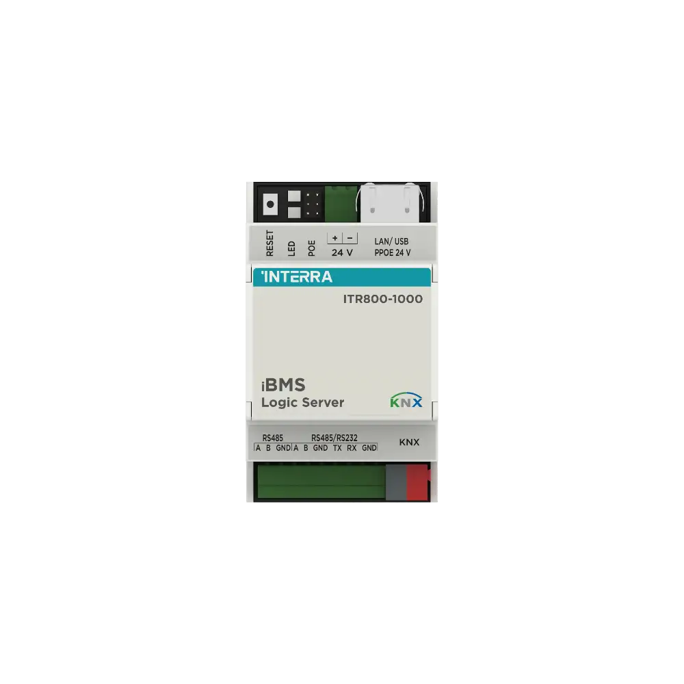


From rooms
3. Solutions Integration
High-level system architecture
IP Network Switch
From Common areas
PMS / BMS
Alarm System
Access Control System
www.interratechnology.com

Slide 18

3. Solutions Integration
Common areas plan type A: combining KNX with DALI
www.interratechnology.com

Slide 19

3. Solutions Integration
Common areas plan type B: NON-KNX Solution
www.interratechnology.com

Slide 20

THANKS
www.interratechnology.com

